Slide 1

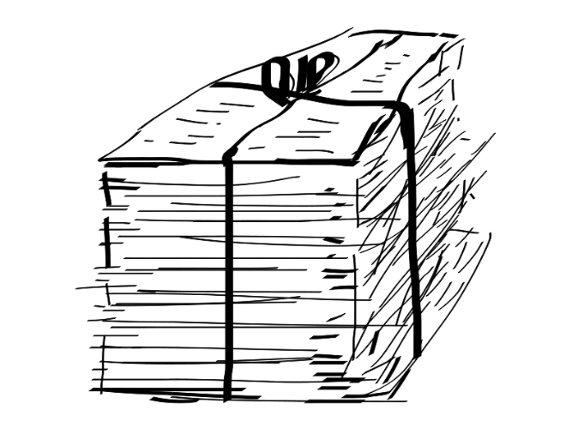


Automatic Text Summarization
Sriram Pillutla

Slide 2
Outline
1. How Text-Analytics is changing public health-care.
2. Different types of text-summarization.
3. Text Normalization
4. Different Approaches to summarize the text.
5. Evaluating Summaries.

Slide 3

Top 4 ways text analytics is changing public health care
1. Monitoring news and reports for epidemic and disease tracking.
“I’m Jacqui Jeras with today’s cold and flu report ... across the mid-Atlantic states, a little bit of an increase here”, January 4, (Jeras 2008)
Source: http://www.robertmunro.com/research/munro12epidemics.pdf

Slide 4
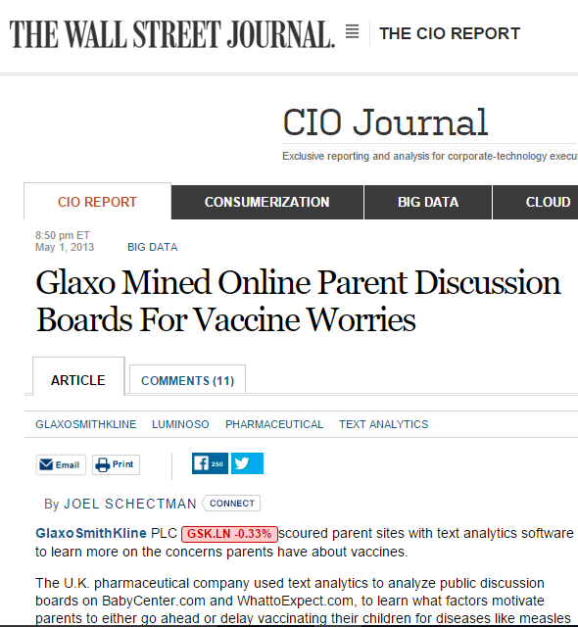
Top 4 ways text analytics is changing public health care
2. Tracking public opinions on controversial health topics.

Slide 5
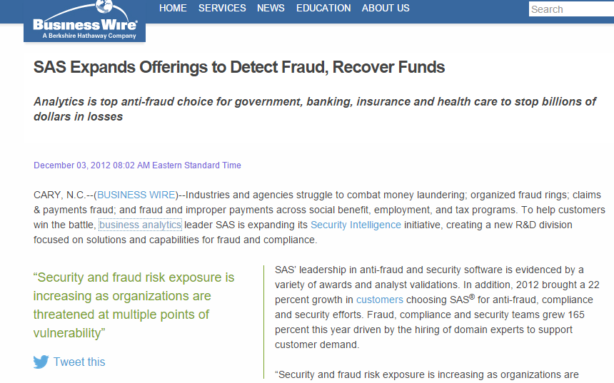
Top 4 ways text analytics is changing public health care
3. Detecting fraud in healthcare.

Slide 6


Top 4 ways text analytics is changing public health care
4. Responding to medical emergencies more quickly in developing parts of the world. (UNICEF U report program)

Slide 7
Extractive summarization & Abstractive summarization
Extraction based text summarization:
Abstraction based text summarization:
The summary generated by extraction is developed based on the words and phrases in the actual text
The summary generated by abstraction techniques does not contain the explicit words of the text. Natural language generation techniques are used to generate the summary

Slide 8
Text Normalization
Tokenization: A tokenizer tokenizes the sentence by words
for example "it didn't feel good" gets into’
["it", "did", "n't", "feel", "good"]
Stemming: crude chopping of affixes.
e.g., automate(s), automatic , automation all reduced to automat.
Compressed and compression are both accepted as equivalent to compress.
Removing stop words: getting rid of unwanted English words (or, and, this, that...)
Notes:
Stem is the core meaning-bearing unit.

Slide 9
Porter’s algorithm The most common English stemmer.
Step 1a
sses -> ss caresses -> caress
ies -> I ponies -> poni
ss ->ss caress -> caress
s -> ᶲ cats -> cat
Step 1b
(*v*)ing -> ᶲ walking -> walk
singing -> sing
(*v*)ed -> ᶲ plastered -> plaster
Step 2( for long stems)
ational -> ate relational -> relate
izer -> ize digitizer -> digitize
ator -> ate operator -> operate
Step 3 (for longer stems)
al -> ᶲ revival -> reviv
able -> ᶲ adjustable -> adjust
ate -> ᶲ activate -> activ

Slide 10
What If we don’t normalize the text?
We want to match U.S.A and USA
Both the words “window” and “windows” are considered as two completely different words while counting the word frequency.
If stop words are not removed they are given same weight as other words.

Slide 11
Word Frequency Based Summarization
H.P Luhn 1958
Sentences with the frequent words constitute the summary.
Example:
“A rocket is a missile, spacecraft, aircraft or other vehicle that obtains thrust from a rocket engine. Rocket engine exhaust is formed entirely from propellant carried within the rocket before use. Rocket engines work by action and reaction and push rockets forward simply by expelling their exhaust in the opposite direction at high speed, and can therefore work in the vacuum of space.
Rocket propellant is a material used by a rocket as, or to produce in a chemical reaction, the reaction mass (propulsive mass) that is ejected, typically with very high speed, from a rocket engine to produce thrust, and thus provide spacecraft propulsion.”

Slide 12
Word Frequency Based Summarization
H.P Luhn 1958
Sentences with the frequent words constitute the summary.
Example:
“A rocket is a missile, spacecraft, aircraft or other vehicle that obtains thrust from a rocket engine. Rocket engine exhaust is formed entirely from propellant carried within the rocket before use. Rocket engines work by action and reaction and push rockets forward simply by expelling their exhaust in the opposite direction at high speed, and can therefore work in the vacuum of space.
Rocket propellant is a material used by a rocket as, or to produce in a chemical reaction, the reaction mass (propulsive mass) that is ejected, typically with very high speed, from a rocket engine to produce thrust, and thus provide spacecraft propulsion.”
Summary: Rocket propellant is a material used by a rocket as, or to produce in a chemical reaction, the reaction mass (propulsive mass) that is ejected, typically with very high speed, from a rocket engine to produce thrust, and thus provide spacecraft propulsion.

Slide 13
Graph Based Summarization
Erkan and Radev 2004
First step: Tf*idf scores are computed for the words.
tf is the frequency of a word in the cluster.
idf_{i} = log(N/n_{i})
Centroid of a document is generated.
Sentences that contain more words from the centroid of the cluster are considered as central.

Slide 14

Sentence similarity Computation
Cosine similarity is calculated for all the sentences having the words from the centroid.

Slide 15
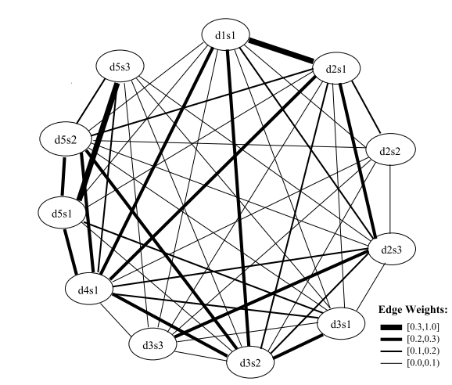
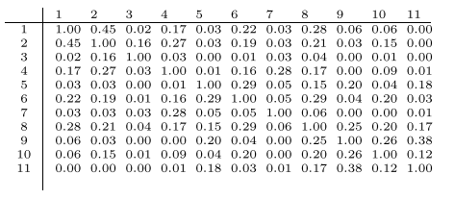
Cosine similarity Representation
Source: http://arxiv.org/pdf/1109.2128.pdf

Slide 16
Constructing Lexical Chains for text summarization
Barzilay and Elhadad 1999
Lexical chains are constructed in three steps
1. Select a set of candidate words;
2. For each candidate word, find an appropriate chain relying on a relatedness criterion among members of the chains;
3. If it is found, insert the word in the chain and update it accordingly.
Relatedness : Extra-strong relations, Strong Relations, medium strong relations.

Slide 17
Example
Mr. Kenny is the person that invented an anesthetic machine which uses micro-computers to control the rate at which an anesthetic is pumped into the blood. Such machines are nothing new. But his device uses two micro-computers to achieve much closer monitoring of the pump feed-ing the anesthetic into the patient.
Micro-computer
Mr.
Machine
Device
Person
Pump

Slide 18
Summary Generation
Concepts represented by strong lexical chains give a better indication of the central topic of a text.
Scoring chains
Score(chain) = Length * HomogenityIndex
HomogenityIndex = 1 – number of DistinctOccurances/length

Slide 19
Summary Generation
StrengthCriterion
Score(chain) > Average(scores) + 2 * StandardDeviation(scores)
Extracting significant sentences.

Slide 20
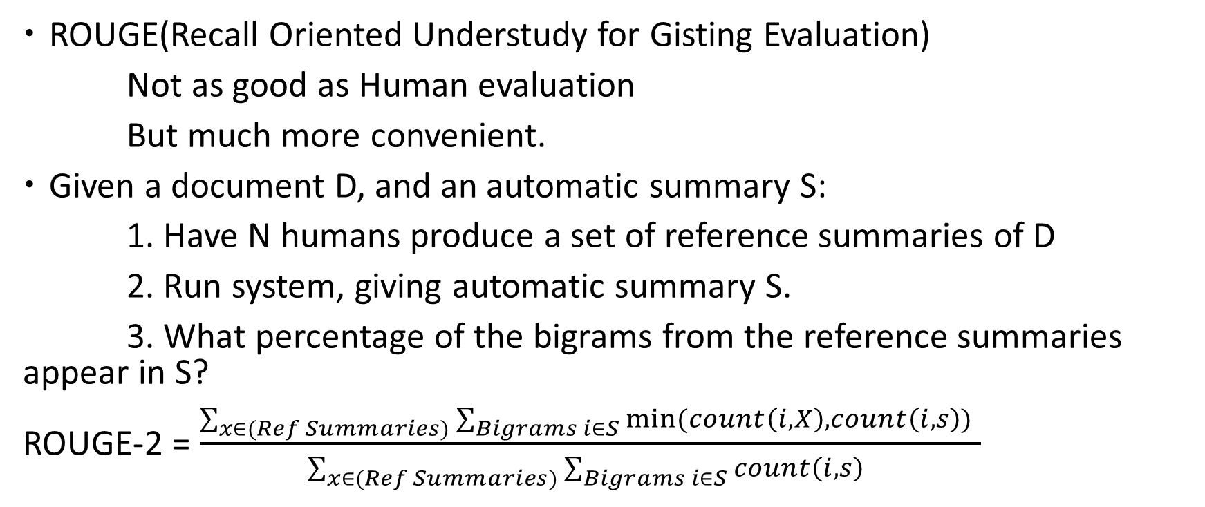
Evaluating Summaries: ROUGE
Lin and Hovy 2003
ROUGE(Recall Oriented Understudy for Gisting Evaluation)
Not as good as Human evaluation
But much more convenient.
Given a document D, and an automatic summary S:
1. Have N humans produce a set of reference summaries of D
2. Run system, giving automatic summary S.
3. What percentage of the bigrams from the reference summaries appear in S?
ROUGE-2 = $\frac{\sum_{x∈(Ref Summaries)}{\sum_{Bigrams i∈S}{min⁡(count\left(i,X\right),count\left(i,s\right))}} }{\sum_{x∈(Ref Summaries)}{\sum_{Bigrams i∈S}{count\left(i,s\right)}} }$

Slide 21
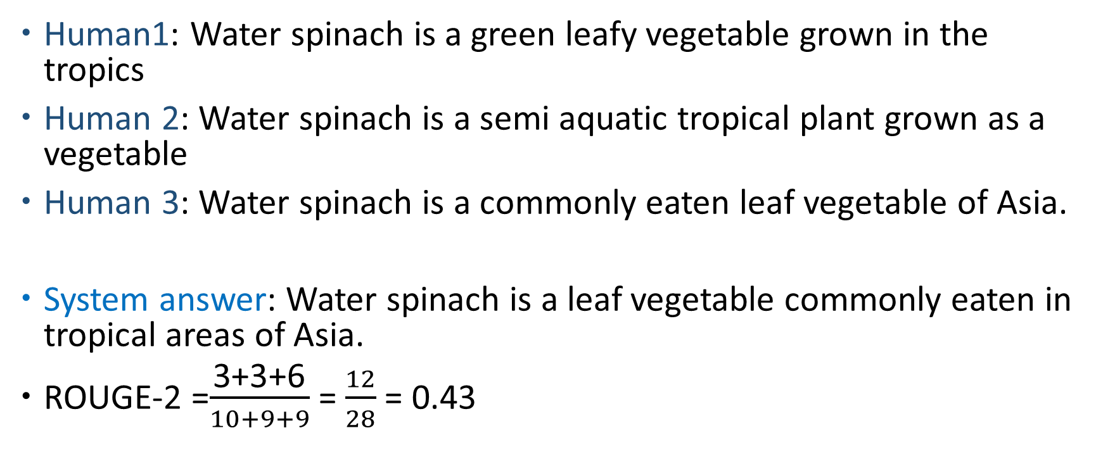
ROUGE example:
Human1: Water spinach is a green leafy vegetable grown in the tropics
Human 2: Water spinach is a semi aquatic tropical plant grown as a vegetable
Human 3: Water spinach is a commonly eaten leaf vegetable of Asia.
System answer: Water spinach is a leaf vegetable commonly eaten in tropical areas of Asia.
ROUGE-2 =$\frac{\text{3+3+6}}{10+9+9}$ = $\frac{12}{28}$ = 0.43

Slide 22
Summary: 6 things from this lecture.
1. How Text Analytics is changing Public Health care.
2. Text Normalization
3. Word Frequency Based Summarization
4. Graph Based summarization
5. Summarization using lexical chains.
6. Evaluating Summaries using ROUGE.

Slide 23
References
Edmundson, H. P. 1969. 'New Methods In Automatic Extracting'. Journal Of The ACM 16 (2): 264-285. doi:10.1145/321510.321519.
Luhn, H. P. 1953. 'A New Method Of Recording And Searching Information'. Amer. Doc. 4 (1): 14-16. doi:10.1002/asi.5090040104.
Barzilay, Regina, and Kathleen R. McKeown. 2005. 'Sentence Fusion For Multidocument News Summarization'. Computational Linguistics 31 (3): 297-328. doi:10.1162/089120105774321091.
J. Carbonell and J. Goldstein, “The use of MMR, diversity-based rerunning for reordering documents and producing summaries,” in Proceedings of the Annual International ACM SIGIR Conference on Research and Development in Information Retrieval, pp. 335–336, 1998.
Otterbacher, Jahna, Gunes Erkan, and Dragomir R. Radev. 2009. 'Biased Lexrank: Passage Retrieval Using Random Walks With Question-Based Priors'. Information Processing & Management 45 (1): 42-54. doi:10.1016/j.ipm.2008.06.004.
V. Hatzivassiloglou, J. L. Klavans, M. L. Holcombe, R. Barzilay, M. yen Kan, and K. R. McKeown, “SIMFINDER: A flexible clustering tool for summariza- tion,” in Proceedings of the NAACL Workshop on Automatic Summarization, pp. 41–49, 2001.
J. Kupiec, J. Pedersen, and F. Chen, “A trainable document summarizer,” in Proceedings of the Annual International ACM SIGIR Conference on Research and Development in Information Retrieval, pp. 68–73, 1995.

Slide 24
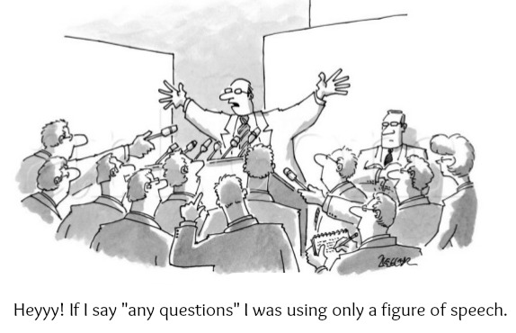
Questions ?

Slide 25
Summary: 6 things from this lecture.
1. How Text Analytics is changing Public Health care.
2. Text Normalization
3. Word Frequency Based Summarization
4. Graph Based summarization
5. Summarization using lexical chains.
6. Evaluating Summaries using ROUGE.

